Slide 1


CE257: DATA COMMUNICATION & NETWORKING
July – November 2020
Chapter – 1
Introduction and Basic Concepts

Slide 2


Objectives
To understand Basic terms of Data Communication
To understand about Network and its Types
To understand about Internet History
To understand about Network Standard
To understand about Network Administration

Slide 3
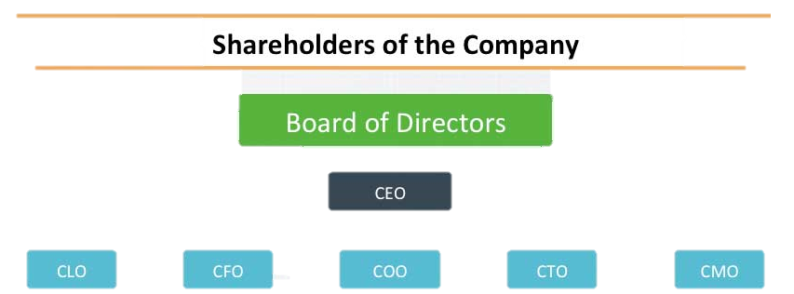
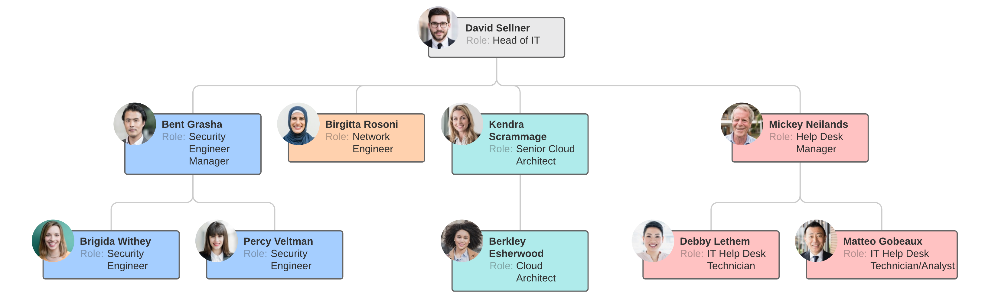
Organizational Structure
System Administrator
Network Administrator
Database Administrator

Slide 4
System Administator
Also known as SysAdmin
They having responsibility of :
  Installing and configuring software, hardware and networks. Monitoring system performance and troubleshooting issues. Ensuring security and efficiency of IT infrastructure
In a big Company SysAdmin responsibility divided in two parts :
  Network Admin
  Database Admin

Slide 5

Data Communication
Communicate means Sharing Information
Sharing can be possible at local(F2F) or
remote(over a distance e.g. Telecommunication - Tele Greek word meaning “Far” )
Data communications are the exchange of data between two devices via some form of transmission medium
  Transmission Medium can be Wired or Wireless
The effectiveness of a data communications system (Hardware and Software) depends on four fundamental characteristics:
  delivery, accuracy, timeliness, and jitter

Slide 6




Communication System Component
Transmission Media
Sender
Receiver
Five Main Component:
Sender
Receiver
Transmission Media
Message
Protocol (set of Rules)
Translator

Slide 7
Message
Message made of different Data Representor
Types of Data Representor
  Text
    Text is represented as a bit pattern, a sequence of bits (O or 1)
    Different sets of bit patterns have been designed to represent text symbols. Each set is called a code, and the process of representing symbols is called coding e.g. Unicode( 32 bits)
  Number
    It can also be able to present in bit patterns. But for mathematical simplicity it converted to binary number
  Image
    An image is composed of a matrix of pixels (picture elements)
    After an image is divided into pixels, each pixel is assigned a bit pattern

Slide 8
Message
Message made of different Data Representor
Types of Data Representor
  Image
    For color image use RGB, YCM or different representation method
  Audio
    Audio is continuous signal, not discrete(like Text, Number, Image)
  Video
    Video refers to the recording or broadcasting of a picture or movie.
    Video can either be produced as a continuous entity (e.g., by a TV camera), or it can be a combination of images, each a discrete entity, arranged to convey the idea of motion

Slide 9
Data Flow
Communication between two devices can be simplex, half-duplex, or full-duplex
 | Simplex | Half-Duplex | Full-Duplex
Direction of Communication | Unidirectional | Bidirectional | Bidirectional
Mode of Device | Can be Sender/Receive Only | At a time Device Can be Sender or Receive only | Device can be work as Sender and Receive both at a same time
Channel shared? | No | No | Yes(divided between the two directions)
Example | Keyboards, Monitor | Walkie-talkies and CB (citizens band) radios | Telephone Network

Slide 10
Network
A network is a set of devices (often referred to as nodes) connected by communication links.
A node can be a computer, printer, or any other device capable of sending and/or receiving data generated by other nodes on the network
Why we need a network ?
  Communication and Collaboration
  Sharing information and resources
  Organizing Data
  Saving Costs
Notes:
1. Collaboration for Business
2. Sharing information like Text and Tweets
3. Organizing Data for maintaining information
4. Saving Costs. By sharing Printer like resources

Slide 11










Node classification
Hosts
Central Connecting Devices
Laptop
Dekstop
Router
Switch
Tablet
Mobile
Hub
Repeater
Wireless Router
Server
Notes:
schematic symbol for a Router
Responsibility for Central Connecting Devices are divided in two :
1. Connecting Hosts
2. Transfering Data

Slide 12

Client Server Relation
Client
Document Printing Request
Client
Client
Server
Client
Service provider known as Server
Service Consumer known as Clients
Example of different Services are Telnet, SSH(Secure Shell),Email

Slide 13
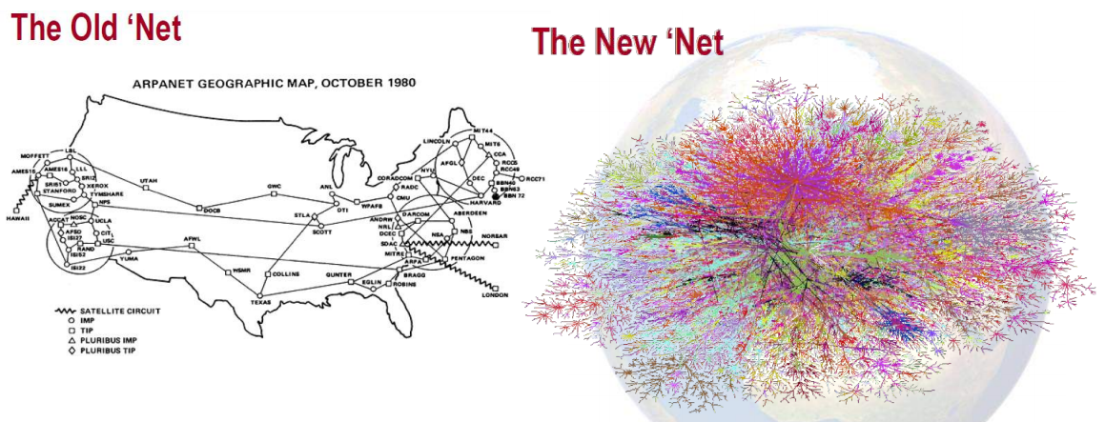
“Net” new definition
The New “Net” monitors & controls critical Infrastructure.
Its integrity & availability is critical for economy, public safety, & national security

Slide 14
Network
A network must be able to meet a certain number of criteria –
  Performance
    throughput and delay
  Reliability
  security

Slide 15
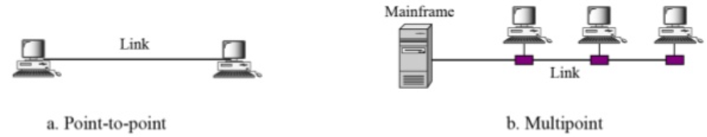
Types of Connection
Point to Point
  Wired ( with actual Size of Cable)
  Wireless (Infrared, microwave, satellite links)
Multipoint( also called Multidrop)
  Spatially Shared: If several devices can use the link simultaneously, it is a spatially shared connection.
  Temporally Shared: If users must take turns, it is a timeshared connection

Slide 16
Physical Topology
Means the way in which a network is laid out physically
The topology of a network is the geometric representation of the relationship of all the links and linking devices (usually called nodes) to one another
Four Basic Topology Types
Mesh | Star | Bus | Ring

Slide 17
Network Standard
Networking standards ensure the interoperability of networking technologies by defining the rules of communication among networked devices. Networking standards exist to help ensure products of different vendors can work together in a network without risk of incompatibility
wireless networking standards like 802.11a
wired networking standards like Ethernet

Slide 18
Categories of Standards
Standards
De facto(by fact)
De jure(by law)
Standards Creation Committee
The International Standards Organization (ISO)
The American National Standards Institute (ANSI)
The Institute of Electrical and Electronics Engineers (IEEE)
The Internet Engineering Task Force (IETF)

Slide 19
Network Administration
Key skills for network administrators
  Patience.
  IT and technical skills.
  Problem-solving skills.
  Interpersonal skills.
  Enthusiasm.
  Teamworking skills.
  Initiative.
  Attention to detail.

